Slide 1

Validation
Learning Objectives:
Introduction of Validation.
Levels of Testing
Different Testing Approaches

Slide 2
Validation
Validation typically involves actual testing and takes place after
the verifications are complete.
Validation determines the correctness of a final build with respect
to its requirements.
Validation checks whether we have built the right product.
Notes:
STCT Book - Page 12

Slide 3
Validation
Disciplined approach to evaluate whether the final product fulfills its specific intended use.
Are we doing the right job?
Also called as dynamic testing.
Done by systematically testing a software product with the intention of finding defects.
Helps in identifying presence of the defects, not their location

Slide 4
Levels Of Testing
Unit Testing
Integration Testing
System Testing
User Acceptance Testing

Slide 5
Unit Testing
Unit - smallest testable piece of software.
Unit test is a procedure used to validate that individual unit of source code is working properly.
Before entering into the unit testing it should be gone through code review.
Tests the functionality of units.
Typically done by the developers and not by testers.
It is typically used to verify control flow, data flow and memory leak problems.

Slide 6
Integration Testing
Integration is a process of combining and testing multiple components together.
Starts at module level when various modules are integrated with each other to form a system.
Considered interfaces on system.
Focuses on design and construction of software architecture.
Approaches:
  Bottom Up
  Top Down
  Critical Part First
  Big Bang approach

Slide 7
What is Bottom Up
Approach
Process of testing the very lowest layers of software first is called the bottom up approach.
Program is tested from bottom to the top.
In this approach, programmers use a temporary program instead of main program, which is under construction.
The temporary program is called “Driver” or “Calling Program”.

Slide 8
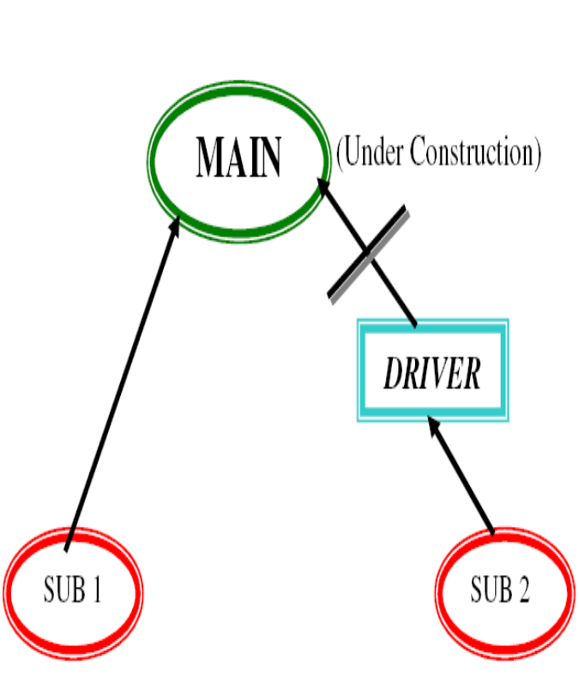
Bottom Up Approach
* In this approach first Child Modules are developed.
* After that parent modules are developed
* Then interconnect Child Modules with Parent Modules.
* In the interconnection Process if there is any main module is under construction then the developers create temporary program that is called “Driver”.

Slide 9
What is Top Down Approach
Process of testing the top most layers of software first is called the Top-Down Approach.
Programmers use temporary programs called “stubs” instead of sub-programs, which are under construction.
The other name for stubs is “Called Programs”.
A stub returns the control to the main program.”

Slide 10
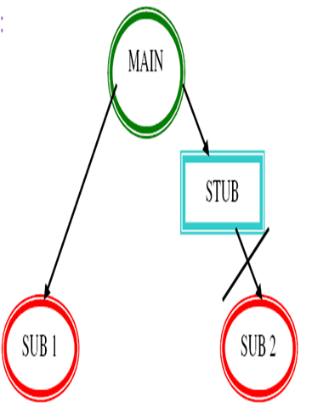
Top down approach
*In this Approach first Parent Modules are developed.
* After that Child Modules are developed.
* Then interconnect Parent & Child Modules.
* In the interconnection process is there any the sub-module is under construction
then the developers create temporary program Instead of sub modules that is
called “Stub”.

Slide 11
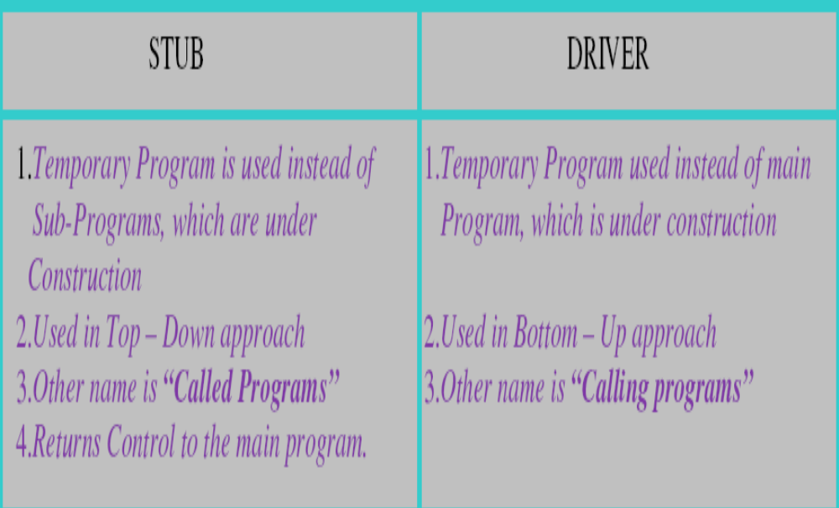
Difference Between STUB &
DRIVER:

Slide 12
Hybrid Approach
(Critical Path First)
Also known as “Sandwich approach”, this is a combination of
the Top-Down Approach & Bottom-Up Approach process.
Both Top-Down & Bottom-Up started simultaneously and testing
is built up from both sides.
It needs big team.
Notes:
Critical Path Analysis is the longest path of planned activities executed in the Shortest Duration to the end of the project.

Slide 13
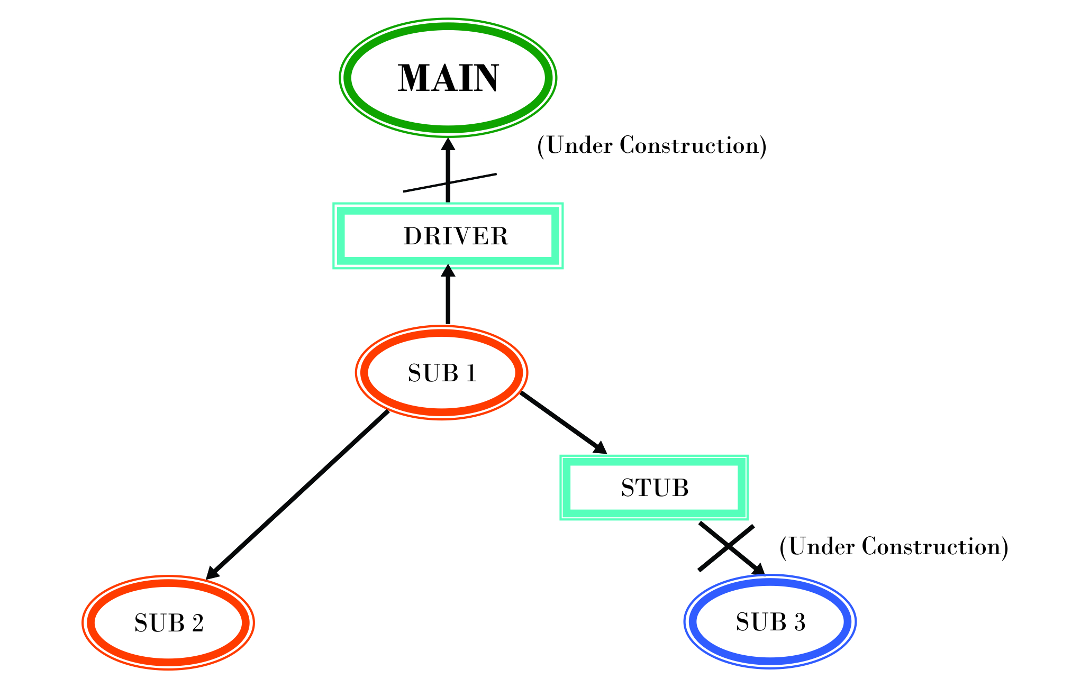
Hybrid approach

Slide 14
Big-Bang Approach
It is also known as “System Approach”.
Big bang approach is the simplest integration testing approach:
  All the modules are simply put together and tested.
  This technique is used only for very small systems.

Slide 15
Big-Bang Approach Issues
Main issues with this approach:
  Errors might be detected very late in the life-cycle of the project.
  If an error is found:
    it is very difficult to localize the error
    the error may potentially belong to any of the modules being integrated.
    Debugging errors found during big bang integration testing are very expensive to fix.

Slide 16
Types Of System Testing
User Interface Testing
Usability Testing
Manual Support Testing
GUI/Behavioural Coverage
Error Handling Coverage
Functional Testing
Functionality Testing
Input Domain Coverage
Sanity Testing
Manipulation Coverage
Order Of Functionality
Smoke Testing
Back End Coverage
Non Functional Testing
Localization Testing
Internationalization
Performance Testing
Recovery Testing
Load Testing
Compatibility Testing
Stress Testing
Configuration Testing
Data Volume Testing
Inter System Testing
Parallel Testing
Installation Testing
Security Testing

Slide 17
System Testing
System testing is the testing of a finally integrated product for compliance against user requirements.
After development of all required modules, the development team releases a software build to be tested on the System Testing Environment.
System testing is classified into 3 levels as
    Usability Testing
    Functional Testing (Black Box Testing Techniques)
    Non Functional Testing

Slide 18
Usability Testing
Also called as accessibility testing.
To check the ease of use for the user.
And how easy is to understand the application and process execution for the user.
This Usability testing consists of two Sub-Techniques:
  a) User – Interface Testing
  b) Manual Support Testing

Slide 19

User Interface testing

Slide 20
User Interface testing
Every screen in the application build is tested for
  Ease of use (understandable).
  Look and feel (attractiveness).
  Speed in interface (short navigations).

Slide 21
Manual support testing
Also known as “Help - documents testing”.
During this test, the testing team concentrates on correctness & completeness of Help – Documents / User Manuals.
Manual support testing is done at the end of Functional and non-functional testing.

Slide 22
Functional Testing
Testing team concentrates on customer requirements in terms of functionality.
Concentrating on requirements correctness and completeness.
This testing is classified into 2 sub tests as follows:
  Functionality Testing
  Sanity testing
  Smoke testing

Slide 23
Functionality testing
Also called as Requirement Testing.
Concentrates on correctness of every functionality with respect to requirements.
Process of verifying whether product meets its design and functional specifications

Slide 24
Functionality Testing
Validating the correctness of every functionality through below coverage’s:
GUI coverage or Behavioral coverage (valid changes in properties of objects and windows in our application build).
Error handling coverage (the prevention of wrong operations with meaningful error messages like displaying a message before closing a file without saving it).
Input Domain coverage (the validity of i/p values in terms of size and type like while giving alphabets to age field).

Slide 25
Functionality Testing
Manipulations coverage (the correctness of o/p or outcomes).
Order of functionalities (the existence of functionality w.r.t. customer requirements).
Back end coverage (the impact of front end’s screen operation on back end’s table content in corresponding functionality).

Slide 26
Smoke Testing
Also called as Basic functional testing.
Checking the testability of the software.
Shallow and wide approach of testing.
Each major function of the software is tested without bothering finer details.

Slide 27
Sanity Testing
Also called as Narrow regression testing.
Checking the behavior of the software.
Narrow and depth approach of testing.
One or few parts of the system is tested in deep.

Slide 28
Smoke Testing Vs Sanity Testing
Smoke Testing | Sanity Testing
Cursory Testing | In-Depth Testing
Wide and Shallow | Narrow and deep
Functional | Subset of Regression Testing
Test cases are Scripted | Test cases are Not-Scripted
Can be Automated | Cannot be Automated

Slide 29
Non-Functionality Testing
Testing team concentrates on characteristics of S/W.
  Recovery Testing
  Compatibility Testing
  Configuration Testing
  Inter system Testing
  Installation Testing
  Performance Testing
  Load Testing
  Stress Testing
  Data Volume Testing
  Parallel Testing
  Security testing

Slide 30
Recovery Testing
It is also called as Reliability testing.
Testing how well system recovers from crashes, hardware failures or sudden problems
With the help of backup and recovery procedures application can go from abnormal to normal state.
Example :
While an application is receiving data from a network, unplug the connecting cable. After some time, plug the cable back in and analyze the applications ability to continue receiving data from the point at which the network connection was terminated.

Slide 31
Compatibility Testing
Also known as Portability testing.
Validates whether the application build is running on customer expected platform or not.
Compatibility testing is done for things like Operating Systems, Compilers, Browsers & Other system software.

Slide 32
Configuration Testing
Also known as “Hardware compatibility testing”.
Validates whether our s/w build is supporting different technology devices or not ?
E.g. different types of printers, disk drives, different n/w technologies etc

Slide 33
Intersystem Testing
It is also known “END – TO – END” Testing.
Testing of interface between two or more systems.
To determine whether parameters and data are correctly passed between applications.
E.g. In shopping mall, billing system and barcode reader are interconnected with each other

Slide 34
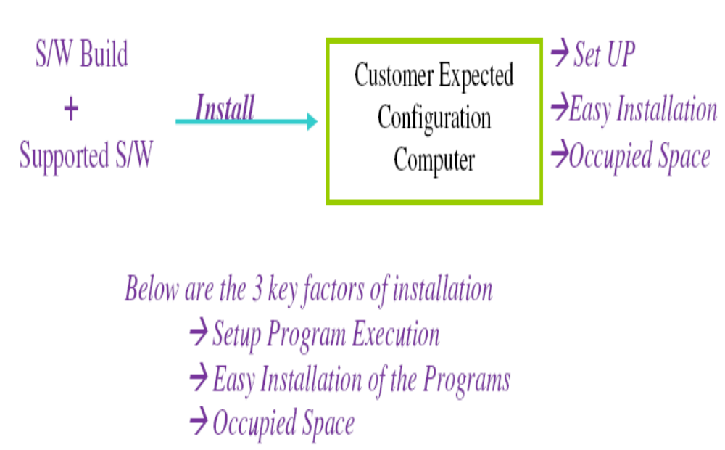
Installation Testing
Checks the installing and uninstalling of the s/w in customer site.

Slide 35
Performance Testing
Checks the response time of application.
Performance means that speed of the processing.

Slide 36
Load Testing
Also called as scalability testing.
Tests the performance of an application on loading the system with max users at same time. Ex: websites, yahoo—G-mail.
Load or Scale means that the number of concurrent users (at the same time) who are operating a s/w.
The execution of our s/w build under customer expected configuration and customer expected load to estimate the performance is LOAD TESTING. (Inputs are customer expected configuration and output is performance).

Slide 37
Stress Testing
The execution of our s/w build under customer expected configuration and various load levels to estimate Stability or continuity is called Stress Testing.
Checks how the system can behave under extremes such as insufficient memory, inadequate hardware etc.

Slide 38
Volume Testing
It’s also known as storage testing or memory testing.
Find weaknesses in the system with respect to its handling of large amounts of data during short time periods.
For example, this kind of testing ensures that the system will process data across physical and logical boundaries such as across servers and across disk partitions on one server.

Slide 39
Parallel testing
It is also known as comparative or competitive testing.
Comparison of two different systems. (old version vs. new version).
Compares with the competitive software in market to estimate competitiveness.
Applicable to S/W product only.

Slide 40
Security Testing
It is also known as Penetration testing.
During this the testing team is validating for:
  Authorization: Access to the valid user and Deny to the invalid users
  Access control: Giving access permissions to the valid users to use specific services like features or functionalities in s/w.
  Encryption or Decryption: Deny to third party access to enter into the system.
  Code conversion is in between client process and server process.

Slide 41
Availability Testing
Availability testing is running an application for a planned period, and collecting failure events with repair times.
It is conducted to check both reliability (finding defects and reducing the number of failures) and availability (measuring and minimizing the actual repair time) of an application.

Slide 42
Internationalization
Testing
Checks the compatibility of an application to all possible languages.
Internationalization is the process of designing a software application so that it can be adapted to various languages and regions without engineering changes.
Globalization testing is the testing technique that ensures compatibility of an application to all possible languages

Slide 43
Localization Testing
Localization is the process of adapting a globalized application to a particular culture/locale.
Localization definition: Localization testing is testing process to validate whether application is capable enough for using in a particular location or country.
In this testing localization, testing is to carried out to check the quality of the product for particular locale/culture.
It is also called as “L10N“, because there as 10 characters in between L & N.
For example of a Zip code field in Sign up form: For localized (country like INDIA), it should allow only numbers in input field. Whereas for UK it should allow Alpha numeric characters.

Slide 44
Other Types of Testing
Mutation testing
Progression Testing
Re-Testing
Regression Testing
Sanity Testing
Smoke testing

Slide 45
Mutation testing
Mutation testing involves modifying a program's source code in small ways to help the tester develop effective tests or locate weaknesses in the code.
Mutation means a change in a program.
Programmers are performing changes in tested program to estimate completeness and correctness of that program.

Slide 46
Progression Testing
and Retesting
Execute the test cases for the first time, it is called progression testing.
Re-executing all the failed test cases to check fixing done by development team is really fixed or not as called as retesting.

Slide 47
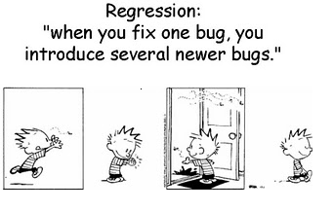
Regression Testing

Slide 48
Regression Testing
Ensuring that a bug is fixed without any side effects is called Regression Testing.
The Re-Execution of selected test cases on modified build to estimate completeness and correctness of the application without any ripple effects due to bug fixes

Slide 49
User Acceptance Testing
Both testers and developers are involved.
After completion of system testing, the project management concentrates on UAT to collect feed back from real customer or model customer.
There are 2 ways to conduct UAT.
  Alpha Testing
  Beta Testing

Slide 50
Alpha Testing and Beta Testing
Alpha Testing | Beta Testing
Performed by end users inside the development organization. | Performed by end users outside the development organization and inside the end user organization.
Done in controlled environment | Environment is not under control
Defects found by end users are noted down by the development team and fixed before release | Defects found by end users are reported to the development organization
Developers are present | Developers are not present

Slide 51
Ad-hoc Testing or informal Testing
In general, every testing team conducts planned testing, but testing team adopts informal testing sometimes due to some challenges or risks.
E.g : Lack of time, lack of resources, lack of team size, lack of skill, etc.
There are different ways of Ad-hoc testing.imes

Slide 52
Ways of Adhoc Testing
Monkey Testing
Due to lack of time, the testing team concentrates on some of the main activities in the software build for testing.
This style of testing is known as “Monkey testing” or “Chimpanzee testing” or “Gorilla testing”.
Buddy Testing
Due to lack of time, the management groups programmers & testers as “Buddies”.
Every buddy group consists of programmers & testers.
E.g.: 1:1 (or) 2:1 (or) 3:1 (preferable)

Slide 53
Ways of Adhoc Testing
Exploratory Testing
Due to lack of proper documentation of the software being built, the test engineers depend on past experience, discuss with others, browse the Internet or Operate similar projects and contact customer side people if possible.
This style of testing is called “Exploratory Testing”.

Slide 54
Ways of Adhoc Testing
Pair Testing
Due to lack of knowledge on project domain the management
groups a senior tester & a Junior Programmers and conducted testing, these all are called Pair testing.
Defect Seeding
To estimate the efficiency of test engineers, the programmers add some bugs to the build. This task is called defect seeding / Bebugging.

Slide 55
Defect Seeding
It is a method in which developers plant defects in the AUT to test the efficiency of the testing process.
It is also used as a method to determine an approximate count of “the number of defects remaining in the application”.

Slide 56
Defect Seeding
Example of Defect Seeding and practical usage:
Let us take an assumption ---
Seeded Defects in the AUT = 100
Discovered Seeded Defects = 75
Actual defects = x
Discovered Defects = 600
From the above statistics, we can infer that testers are able to find 75 out of 100 defects; which is 75% of the total defects present in the AUT.
The number of defects remaining in the application can be calculated as:
Actual Defects - Discovered Defects

Slide 57
Defect Seeding
Example of Defect Seeding and practical usage conti…
The actual defects can be calculated as:
Discovered Defects*Seeded Defects
Discovered Seeded Defects
Putting the above values in the formula: (600*100) / 75 = 800 Defects.
Remaining Defects: 800 – 600 = 200
Hence, by following this method, testers get an idea of the amount of testing to be done on the application so as to improve the efficiency of the testing process.

Slide 58
Difference Between Mutation Testing and Defect Seeding
Mutation Testing | Defect Seeding
Mutation Testing is testing the program by changing the logic. | Defect Seeding is the deliberate injection of defects . It is also called as Be-bugging.
It is done to improve the system performance and usability of the system. | Defect Seeding acts as a reliability method for the release of the project by checking the test coverage.
It is done to check the effectiveness of the application. | It is done to check the efficiency of the testers.

Slide 59
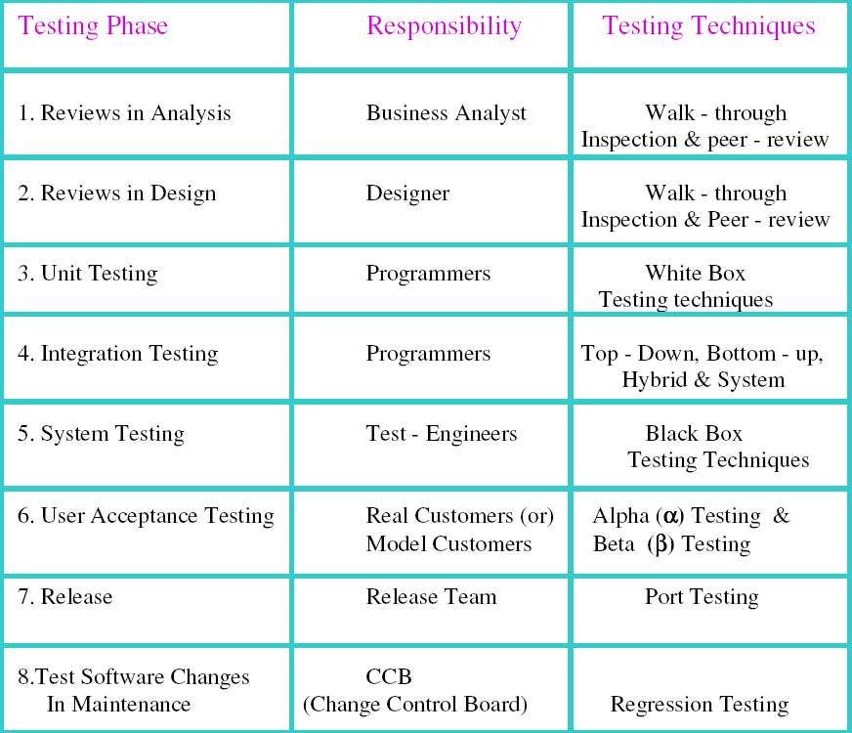

Slide 60
Question
What is VV model ?
Difference between Verification and Validation?
What is Walkthrough and Inspection?
How many basic types of testing are there and
what is the difference ?
Which are the different approaches in Integration testing ?
What are the different coverage in functional testing ?
What is alpha and beta testing?
What is stub and driver ?
What is functionality testing ?
What is Load and stress testing . Explain with example?
Difference between smoke and sanity testing ?
Difference between re-testing and regression testing ?
What is ad-hoc testing ?

Slide 61



